Slide 1

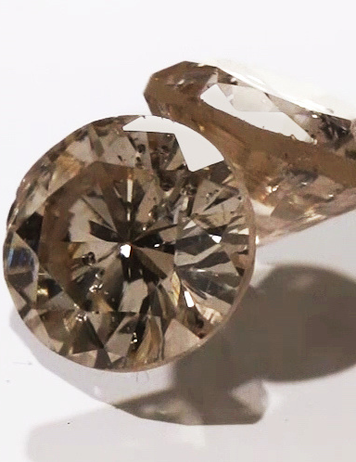
Gemstone Price Prediction
Stone Price Prediction using Regression Analysis
Presented by :
Ahad Almutairi
Rayan Almuwayni
Abdulsalam Alqarni
AS Project 2 SDAIA data science Bootcamp(T5)

Slide 2
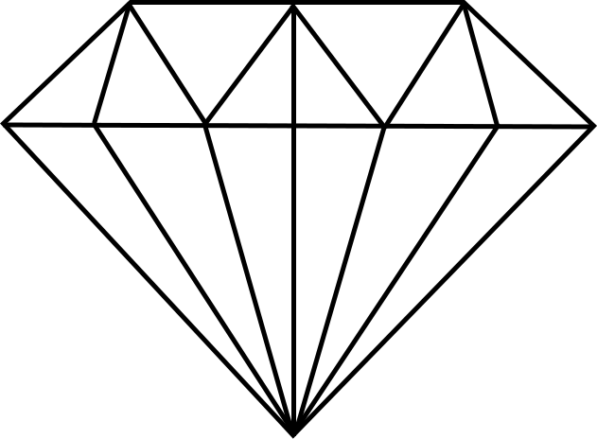
Outline :
Back Story Work Flow Data Cleaning Objects EDA-Analysis
Algorithms Models Challenges Tools Conclusion
01.
02.
03.
04.
05.
06.
07.
08.
09.
10.

Slide 3
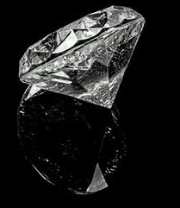
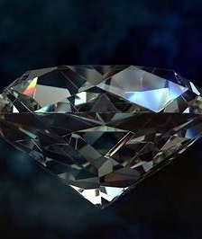
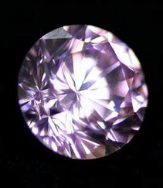
BACK STORY :
Gemstones are different types of polymerized minerals that consist of two or more elements and are mainly composed of silica with the presence of some mineral impurities. The type of gemstones varies with different colors, sizes and the material that is made up in it. In our project, we will used one type of gemstones that is cubic zirconia.

Slide 4
WORK FLOW :
TESTING
MODEL
DATA
CLEANING
EDA
ANALISIS
BULDINGMODEL

Slide 5
DATA CLEANING :
Dataset from KAGGLE.COM and contains 26967 rows × 11 columns
Drop two columns , So we have 9 columns
We have 3 columns with null values and replace them by mean
We have 5 columns with outlier

Slide 6

OBJECTS :
Which color is the best of selling stone?
What is the best clarity of selling stone?
Does the quality of stone affect its price?
What is the highest and lowest value of the stone based on its price?

Slide 7
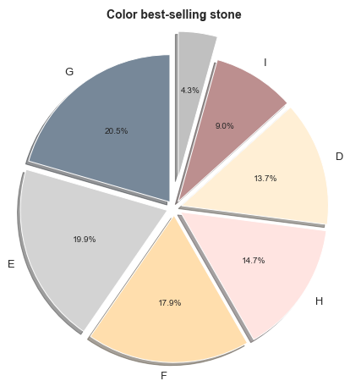
EDA ANALYSIS:
WHICH COLOR IS THE BEST OF SELLING STONE?

Slide 8
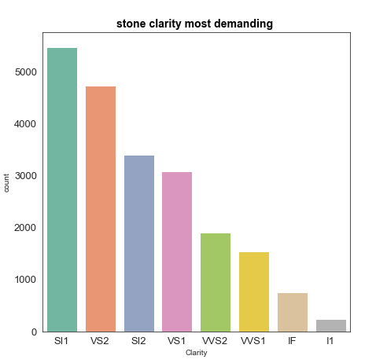
EDA ANALYSIS:
WHAT IS THE BEST CLARITY OF SELLING STONE?

Slide 9
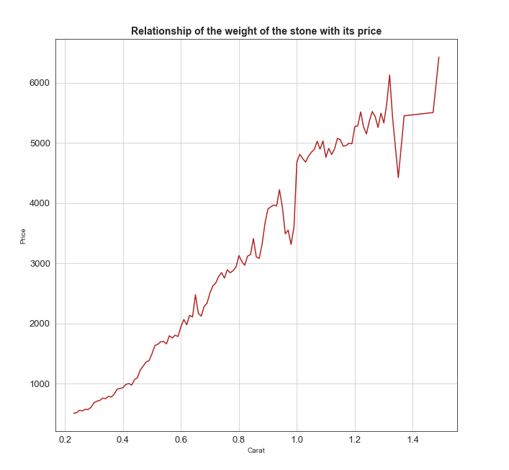
EDA ANALYSIS:
WHAT IS THE HIGHEST AND LOWEST VALUE
OF THE STONE BASED ON ITS PRICE?

Slide 10
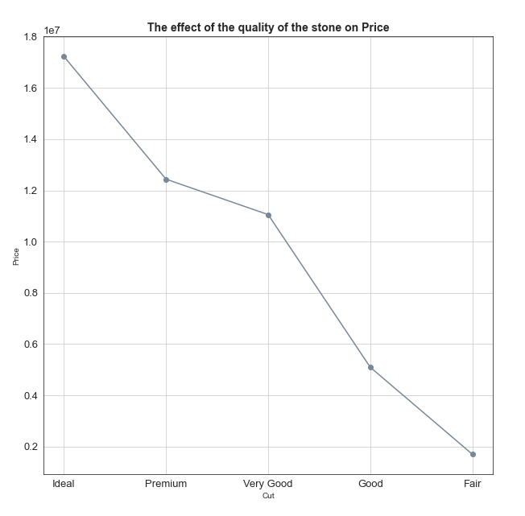
EDA ANALYSIS:
DOES THE QUALITY OF STONE AFFECT ITS PRICE?

Slide 11
AL GORITHMS :
Linear Regression
Ridge Regression
Polynomial Regression
Decision Tree Regression

Slide 12
MODELS :
Algorithms | Train | Test
Linear Regression | 0.9446 | 0.9451
Ridge Regression | 0.9446 | 0.9449
Polynomial Regression | 0.9675 | 0.9681
Decision Tree Regression | 0.9447 | 0.9452

Slide 13
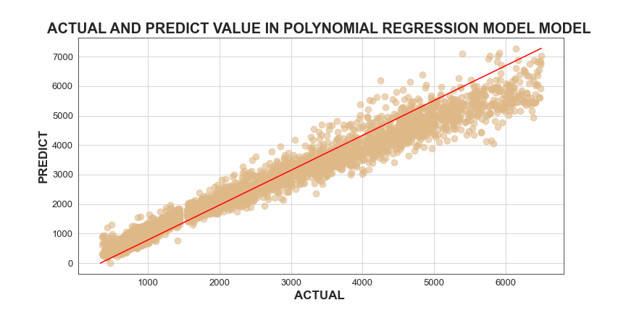
Best Model :
We are note that the best model is :
POLYNOMIAL REGRESSION

Slide 14
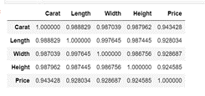
CHALLENGES :
We have 5 columns with very large outliers:
Price
Height
Width
Length
carat
We have 3 columns of inputs that have a strong relationship to each other
so we solved this problem by creating a new column and combining
these 3 columns with a mathematical equation

Slide 15
TOOLS :
Technologies
Jupyter Notebook , Python
Libraries
Pandas , Numpy , Matplotlibe , Seaborn , Sklearn , patsy
Canva
Presentation the project
Zoom
Group Meeting

Slide 16
CONCLUSION:
We were compared the quality , color and weight of the gemstone with the price. And we were noticed that cubic zirconia stone price is high
Therefore, our goal in this project is try to decrease the weight or quality of stone for some middle-income customers who want to gets this kind of gemstones

Slide 17
THANK YOU
FOR YOUR KIND ATTENTION

